Slide 1
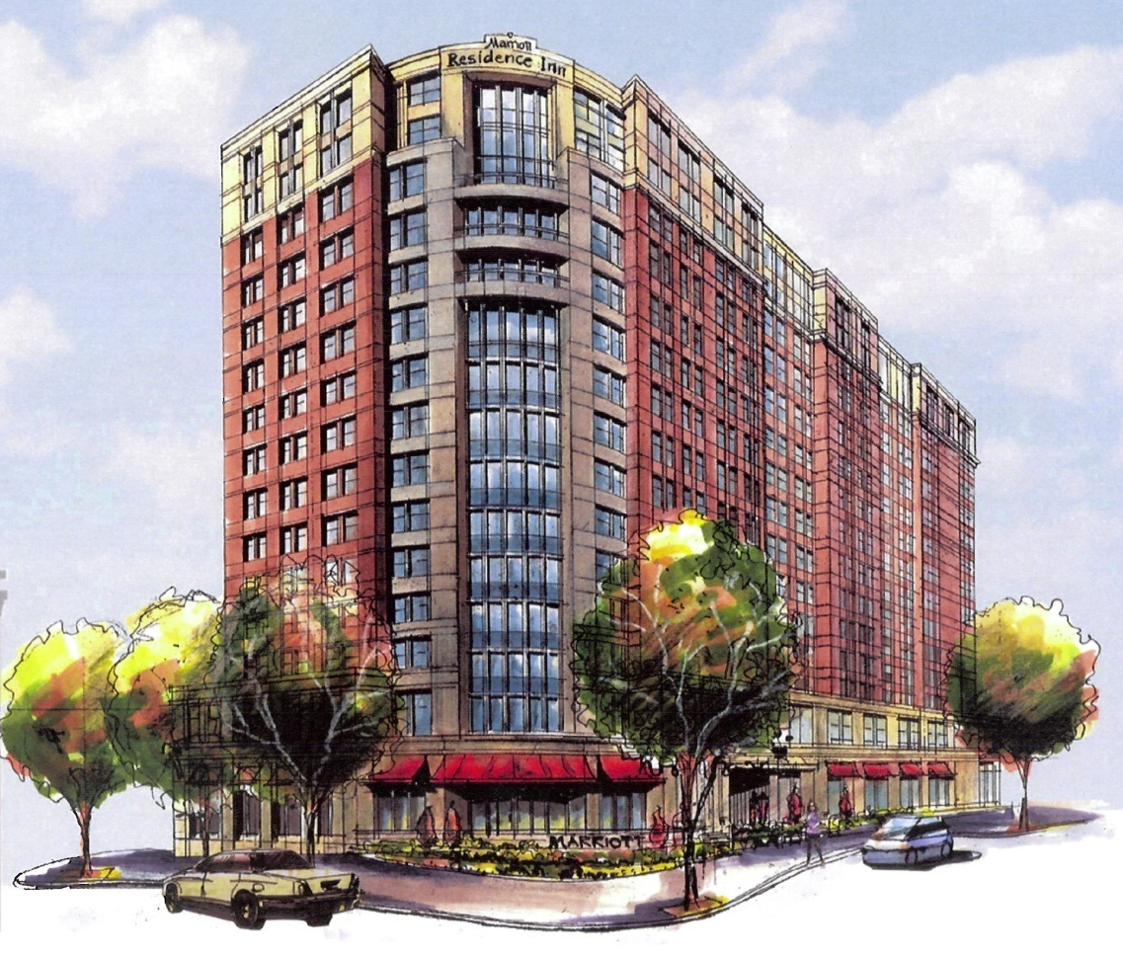
Residence Inn by Marriott
Alexandria, Va
Julia Phillips Construction Management

Slide 2
Presentation Outline
  Project Overview
  Analysis 1: Structural Breadth
  Analysis 2: Controls Breadth
  Analysis 3: Greywater Breadth
  Critical Industry Research: “Greening” of Hotels
  Conclusions

Slide 3

Project Overview
PROJECT OVERIVEW
ANALYSIS 1:
STRUCTURAL RE-DESIGN
ANALYSIS 2:
CONTROLS
ANALYSIS 3:
GREYWATER
CRITICAL INDUSTRY RESEARCH:
“GREENING” OF HOTELS
CONCLUSION
Size: 15 Stories, 127,000 SF w/ 3 Levels Underground Parking
Construction Cost: $33.5 Million
Schedule: March 2007 – August 2008

Slide 4

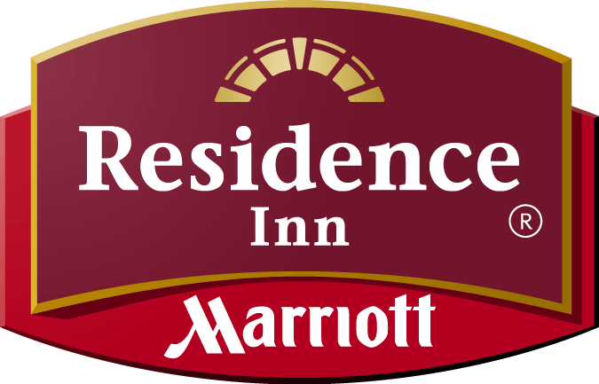
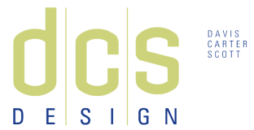




Project Team
PROJECT OVERIVEW
ANALYSIS 1:
STRUCTURAL RE-DESIGN
ANALYSIS 2:
CONTROLS
ANALYSIS 3:
GREYWATER
CRITICAL INDUSTRY RESEARCH:
“GREENING” OF HOTELS
CONCLUSION
Tenant
Owner
Architect
Construction Manager
Structural Engineer
Electrical Engineer
Mechanical Engineer

Slide 5
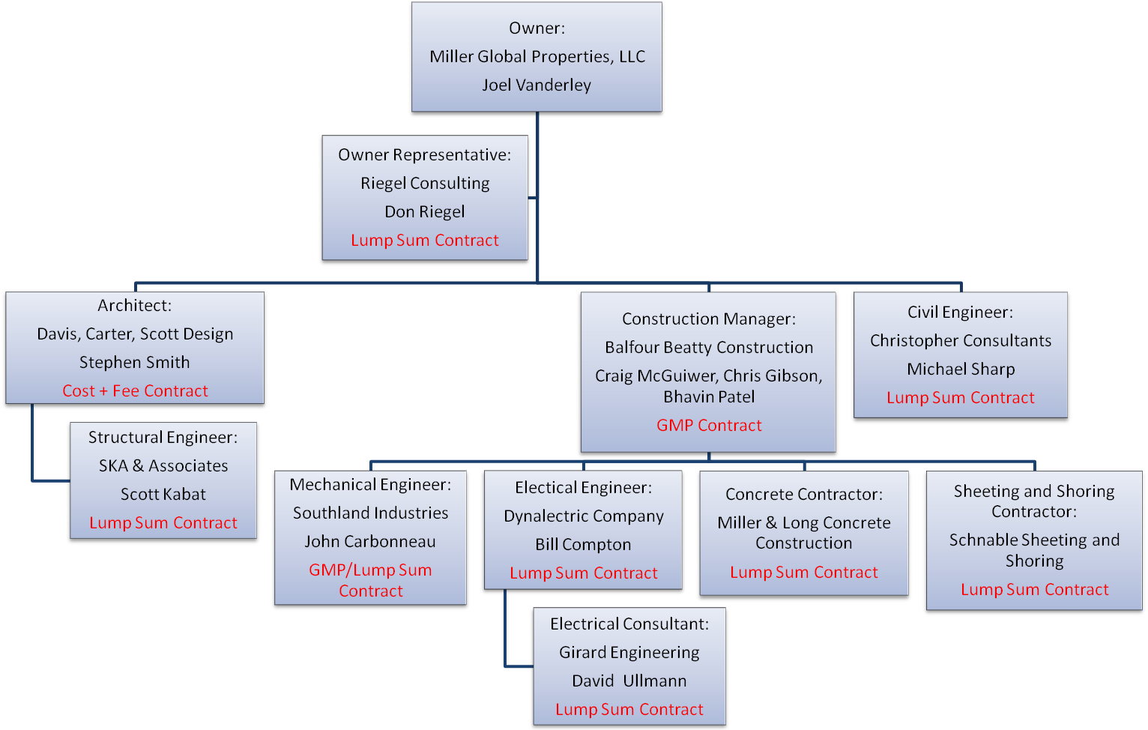
Delivery Method
PROJECT OVERIVEW
ANALYSIS 1:
STRUCTURAL RE-DESIGN
ANALYSIS 2:
CONTROLS
ANALYSIS 3:
GREYWATER
CRITICAL INDUSTRY RESEARCH:
“GREENING” OF HOTELS
CONCLUSION
CM @ Risk w/ GMP → Traditional Design – Bid – Build
MEP → Design – Build

Slide 6
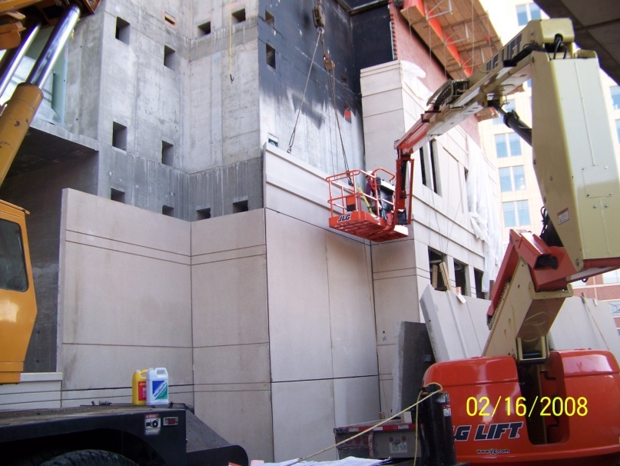
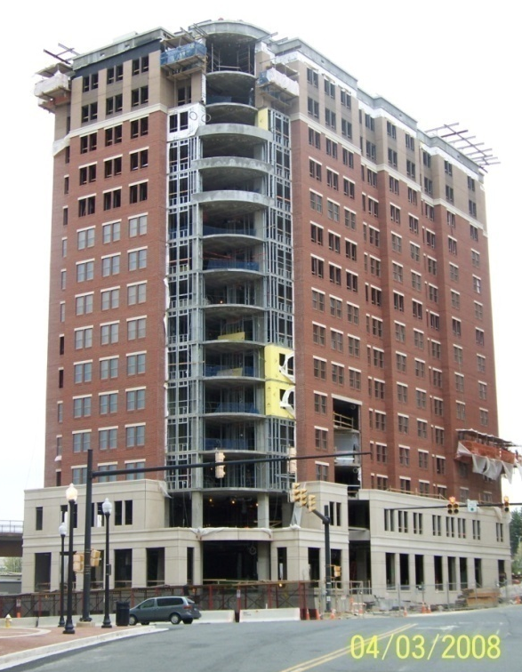
Building Systems
PROJECT OVERIVEW
ANALYSIS 1:
STRUCTURAL RE-DESIGN
ANALYSIS 2:
CONTROLS
ANALYSIS 3:
GREYWATER
CRITICAL INDUSTRY RESEARCH:
“GREENING” OF HOTELS
CONCLUSION
Architecture
  Off-set exterior edge
  Punch-out windows
  Brick and pre-cast façade with CMU back up
  “Column of Light”
  20 LEED points

Slide 7
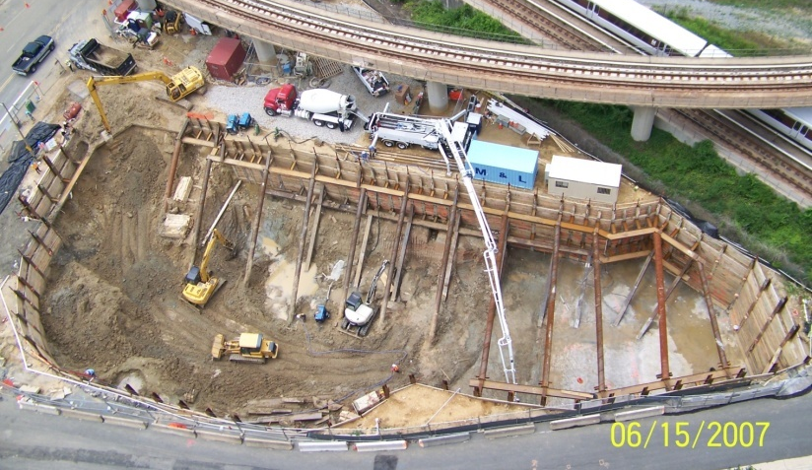
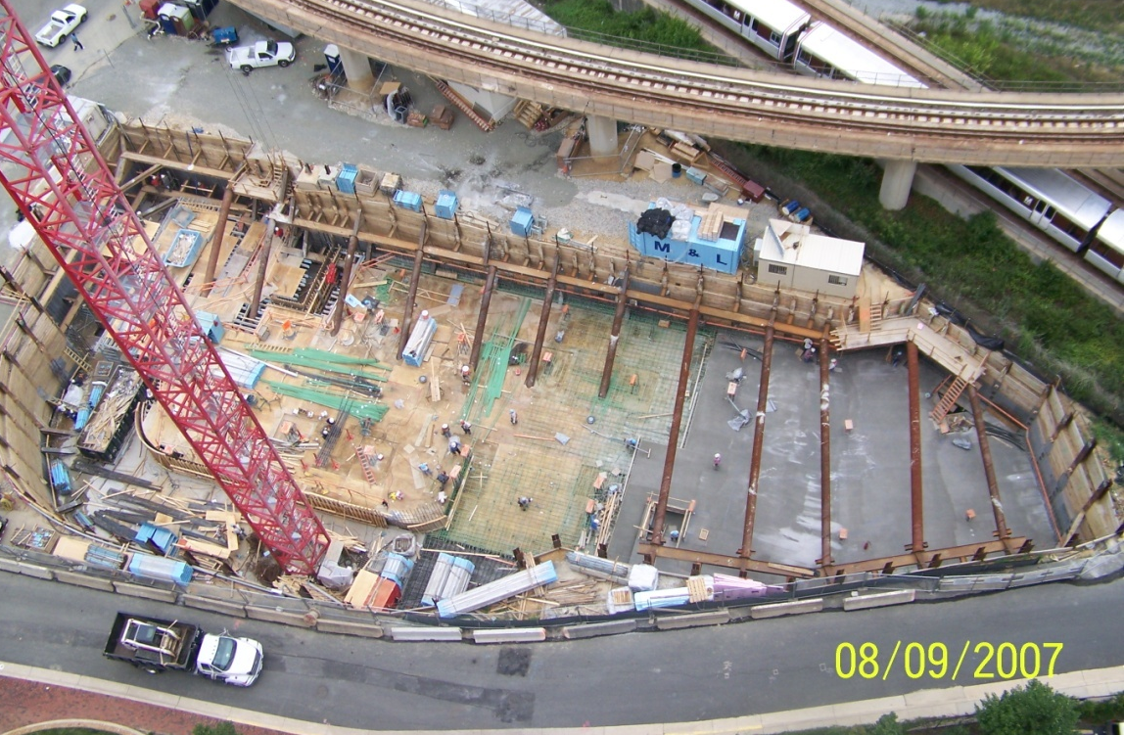
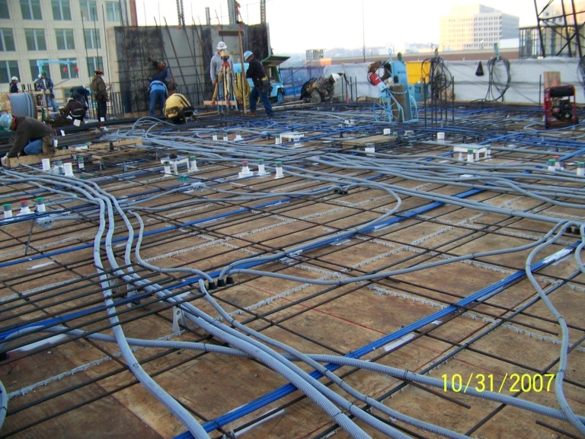
Building Systems
PROJECT OVERIVEW
ANALYSIS 1:
STRUCTURAL RE-DESIGN
ANALYSIS 2:
CONTROLS
ANALYSIS 3:
GREYWATER
CRITICAL INDUSTRY RESEARCH:
“GREENING” OF HOTELS
CONCLUSION
Structural
  3’ Mat slab - Foundation
  8” CIP slab with drop panels - Garage
  7.5” post-tensioned floor slabs - Tower

Slide 8
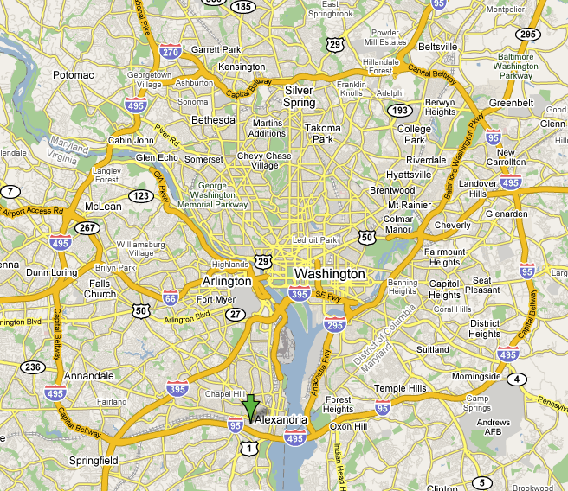
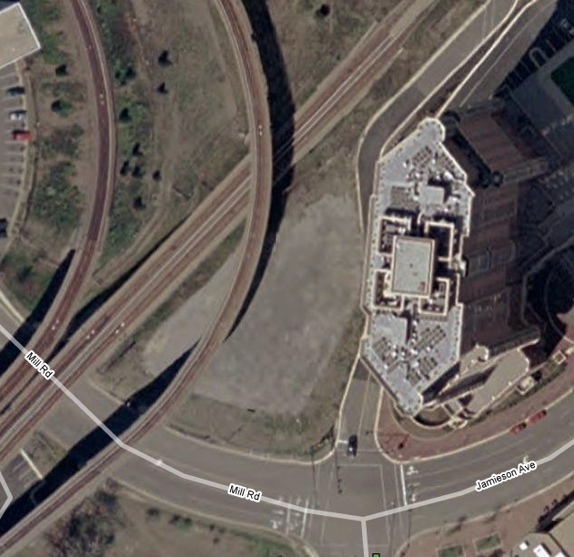
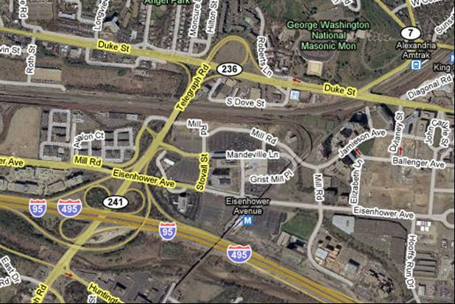
Site Conditions
PROJECT OVERIVEW
ANALYSIS 1:
STRUCTURAL RE-DESIGN
ANALYSIS 2:
CONTROLS
ANALYSIS 3:
GREYWATER
CRITICAL INDUSTRY RESEARCH:
“GREENING” OF HOTELS
CONCLUSION
WMATA Metro
Metro Tracks
Site Boundary
Site access from I-495
Residence Inn
Building Site
Mill Rd.
Capital Beltway I-495

Slide 9
Analysis 1: Structural Re-Design of Underground Garage

Slide 10
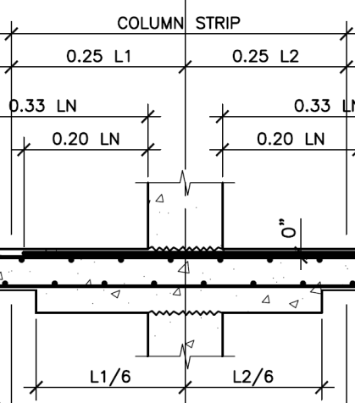
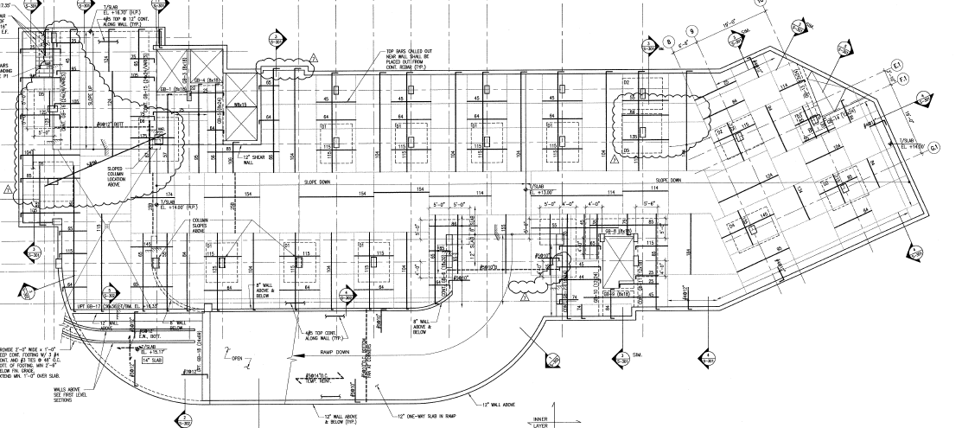
Re-Design of Underground Garage
PROJECT OVERIVEW
ANALYSIS 1:
STRUCTURAL RE-DESIGN
ANALYSIS 2:
CONTROLS
ANALYSIS 3:
GREYWATER
CRITICAL INDUSTRY RESEARCH:
“GREENING” OF HOTELS
CONCLUSION
Background
  8” slab with 5.5” drop panels = 13.5”
  Cure to full 28 day strength
  Unexpected Water Issues

Slide 11
Re-Design of Underground Garage
PROJECT OVERIVEW
ANALYSIS 1:
STRUCTURAL RE-DESIGN
ANALYSIS 2:
CONTROLS
ANALYSIS 3:
GREYWATER
CRITICAL INDUSTRY RESEARCH:
“GREENING” OF HOTELS
CONCLUSION
Goal
  Decrease floor depth, minimize materials, accelerate schedule
  Utilize Flat Plate OR Filigree Slab and Beam System
  Compare Original, Flat Plate, Filigree
        Lbs. / SF of Steel
        Total steel tonnage
        Steel Cost
        CY of Concrete
        Depth of slab, beam, and drop panel
        Concrete Cost
        Total formwork SF
        Formwork Cost
        Total Duration

Slide 12
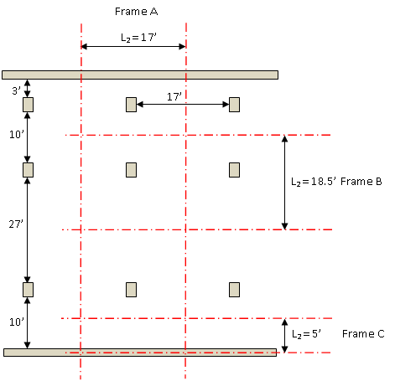
Flat Plate Design
PROJECT OVERIVEW
ANALYSIS 1:
STRUCTURAL RE-DESIGN
ANALYSIS 2:
CONTROLS
ANALYSIS 3:
GREYWATER
CRITICAL INDUSTRY RESEARCH:
“GREENING” OF HOTELS
CONCLUSION
Eliminate Drop Panels by Direct Design Method
h = 10 in. d = 8.50 in.
* Assume Columns are In Line
* Assume 10 Column Lines
* Assume All Columns are 18" x 30"
* Frame C is Doubled
Frame B @ 17'
Frame A @ 27'
Frame A @ 10'
Frame C @ 17'

Slide 13
Flat Plate Design
PROJECT OVERIVEW
ANALYSIS 1:
STRUCTURAL RE-DESIGN
ANALYSIS 2:
CONTROLS
ANALYSIS 3:
GREYWATER
CRITICAL INDUSTRY RESEARCH:
“GREENING” OF HOTELS
CONCLUSION
Results
 |  | Column Strip |  |  |  | Middle Strip
Description |  | M_{EXT}⁻ | M_{EXT}⁺ | M_{INT}⁺ | M_{INT}⁻ | M_{EXT}⁻ | M_{EXT}⁺ | M_{INT}⁺ | M_{INT}⁻
Frame A @ 10' |  |  |  | (6) #6 | (10) #6 |  |  | (10) #4 | (10) #4
Frame A @ 27' |  | (6) #6 | (6) #6 | (6) #6 |  | (6) #5 | (10) #4 | (10) #4
Frame B @ 17' |  |  |  | (5) #6 | (5) #6 |  |  | (13) #4 | (13) #4
Frame C @ 17' |  |  |  | (2) #4 | (3) #4 |  |  | (5) #4 | (5) #4
Analysis Description | Re-Designed CIP Slab without Drop Panels
Steel (TONS) | 42.10
Steel (lbs./SF) | 1.91
Concrete (CY) | 1361.11
Concrete Drop/Beam (in.) | 0
Concrete Slab (in.) | 10

Slide 14
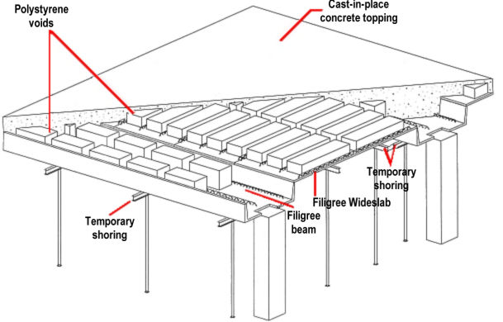
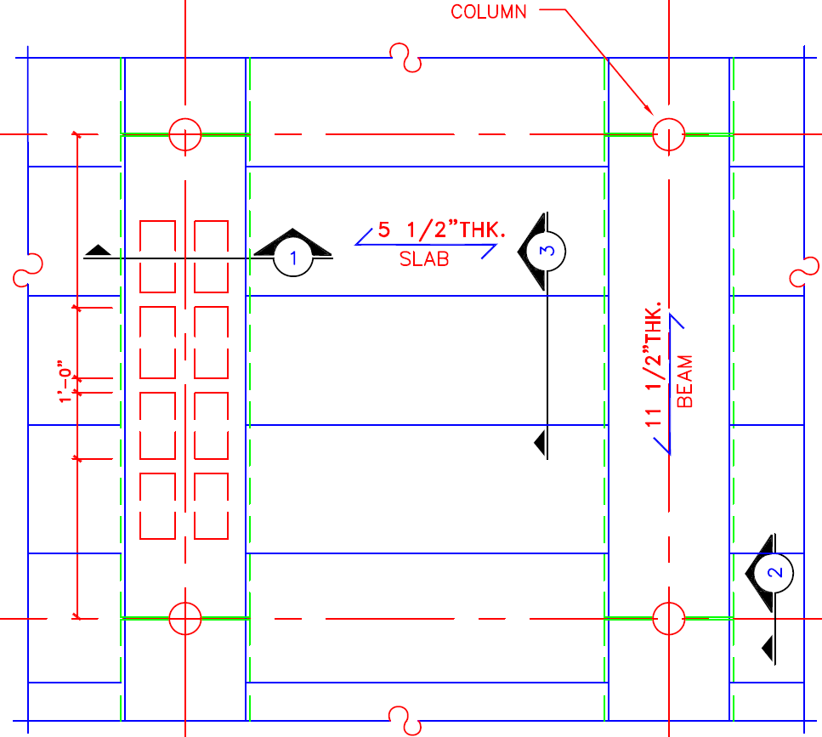
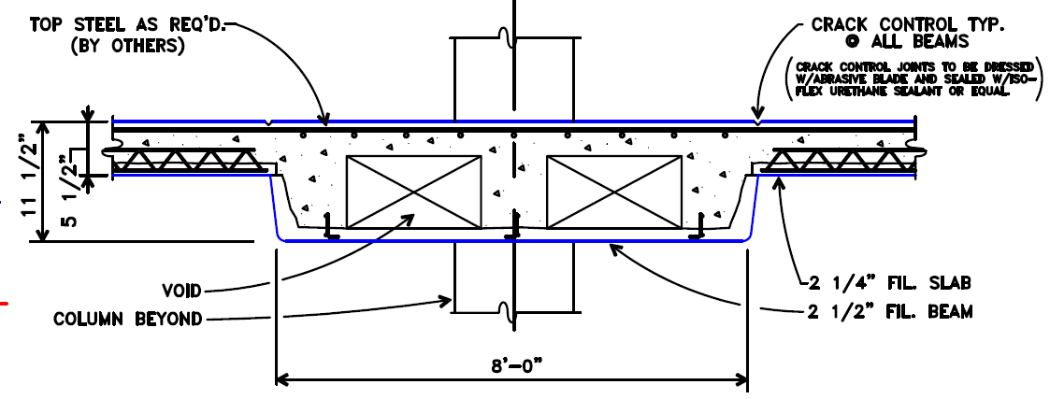
Filigree Slab & Beam Design
PROJECT OVERIVEW
ANALYSIS 1:
STRUCTURAL RE-DESIGN
ANALYSIS 2:
CONTROLS
ANALYSIS 3:
GREYWATER
CRITICAL INDUSTRY RESEARCH:
“GREENING” OF HOTELS
CONCLUSION
Analysis Description | Filigree Slab and Beam System
Steel (TONS) | 48.00
Steel (lbs./SF) | 2.25
Concrete (CY) | 816.67
Concrete Drop/Beam (in.) | 11.5
Concrete Slab (in.) | 6

Slide 15
System Comparison
PROJECT OVERIVEW
ANALYSIS 1:
STRUCTURAL RE-DESIGN
ANALYSIS 2:
CONTROLS
ANALYSIS 3:
GREYWATER
CRITICAL INDUSTRY RESEARCH:
“GREENING” OF HOTELS
CONCLUSION
Structural System Comparison
Analysis Description | Existing CIP Slab with Drop Panels | Re-Designed CIP Slab without Drop Panels | Filigree Slab and Beam System
Steel (TONS) | 61.99 | 42.10 | 48.00
Steel (lbs./SF) | 2.81 | 1.91 | 2.25
Steel Cost | $87,096.81 | $59,144.32 | $67,440.00
Concrete (CY) | 1346.58 | 1361.11 | 816.67
Concrete Drop/Beam (in.) | 13.5 | 0 | 11.5
Concrete Slab (in.) | 8 | 10 | 6
Concrete Cost | $590,207.48 | $596,575.00 | $357,945.00
Formwork (SF) | 46007.95 | 44100.00 | 44100.00
Formwork Cost | $253,043.74 | $242,550.00 | $142,575.30
Slab Duration (Days) | 44 | 27 | 21
Total Cost | $930,348.02 | $898,269.32 | $567,960.30
Location Factor Adjustment | 0.94 | 0.94 | 0.94
Adjusted Total Cost | $874,527.14 | $844,373.16 | $533,882.68
Savings Analysis
Steel (TONS) | n/a | 19.90 | 13.99
Steel (lbs./SF) | n/a | 0.90 | 0.56
Steel Cost | n/a | $27,952.49 | $19,656.81
Concrete (CY) | n/a | -14.53 | 529.92
Concrete Cost | n/a | -$6,367.53 | $232,262.48
Formwork (SF) | n/a | 1907.95 | 1907.95
Formwork Cost | n/a | $10,493.74 | $110,468.44
Slab Duration (Days) | n/a | 17 | 23
Total Cost Savings | n/a | $32,078.70 | $362,387.72
Location Factor Adjustment | 0.94 | 0.94 | 0.94
Adjusted Total Cost Savings | n/a | $30,153.98 | $340,644.45

Slide 16
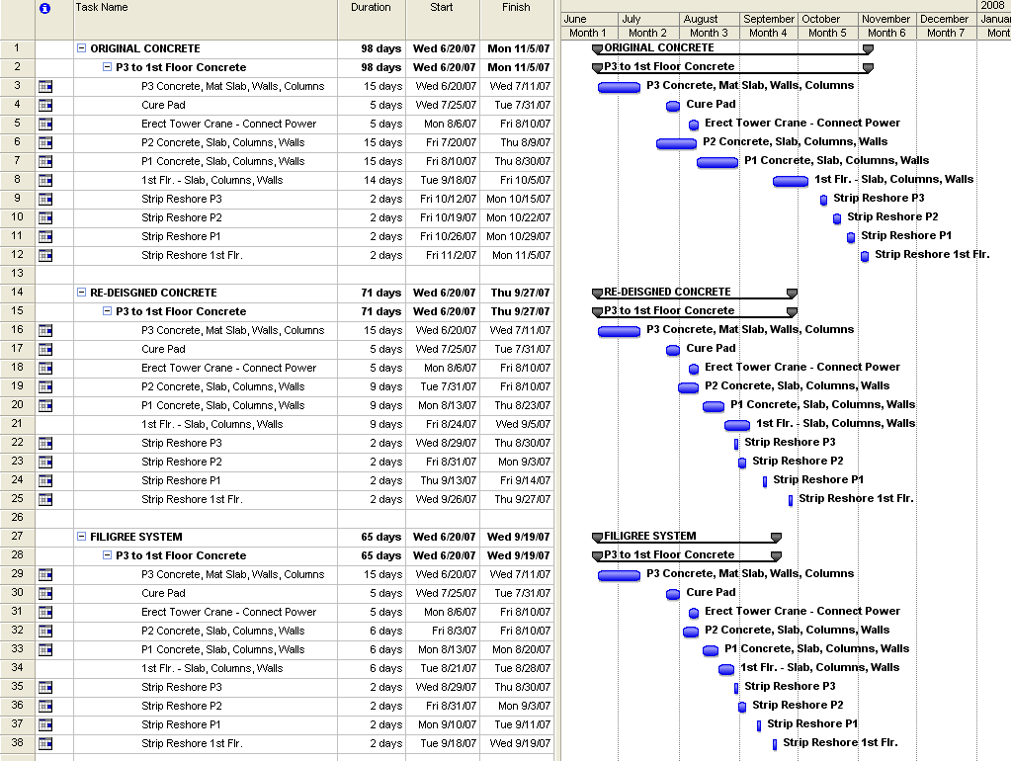
Schedule Reduction
PROJECT OVERIVEW
ANALYSIS 1:
STRUCTURAL RE-DESIGN
ANALYSIS 2:
CONTROLS
ANALYSIS 3:
GREYWATER
CRITICAL INDUSTRY RESEARCH:
“GREENING” OF HOTELS
CONCLUSION
System | Price/Unit | Units | Schedule | Time | Revenue
10" CIP | $180 | 147 | 27 Days | 37 Nights | $979,020.00
Filigree | $180 | 147 | 33 Days | 45 Nights | $1,190,700.00

Slide 17
Conclusion & Recommendation
PROJECT OVERIVEW
ANALYSIS 1:
STRUCTURAL RE-DESIGN
ANALYSIS 2:
CONTROLS
ANALYSIS 3:
GREYWATER
CRITICAL INDUSTRY RESEARCH:
“GREENING” OF HOTELS
CONCLUSION
Filigree slab and beam system is the recommended system.
  Smaller overall depth which is key in designing clearance heights and piping and plumbing work.
  Construction is 33 days faster which enables an early opening.
  Saves the owner $340,644.45 in construction cost.
  Add additional revenue of $1.2 million within the first 45 nights.

Slide 18
Analysis 2: Mechanical Controls

Slide 19
Mechanical Controls
PROJECT OVERIVEW
ANALYSIS 1:
STRUCTURAL RE-DESIGN
ANALYSIS 2:
CONTROLS
ANALYSIS 3:
GREYWATER
CRITICAL INDUSTRY RESEARCH:
“GREENING” OF HOTELS
CONCLUSION
Background
  WMATA metro tracks create 102 dB noise level.
  Half of the noise is blocked by the façade. The FCU’s create white noise to help guests sleep at night.
    Original System
      Fan Coil Units running 24 / 7 to block out noise.
    INNCOM System
      Highly intelligent utilizes door switches, temperature and occupancy sensors.
      Activated when a guest checks in at the front desk, otherwise the systems in unoccupied rooms are off.
      Runs at a low fan speed throughout the night to mask noise.

Slide 20
Mechanical Controls
PROJECT OVERIVEW
ANALYSIS 1:
STRUCTURAL RE-DESIGN
ANALYSIS 2:
CONTROLS
ANALYSIS 3:
GREYWATER
CRITICAL INDUSTRY RESEARCH:
“GREENING” OF HOTELS
CONCLUSION
Goal
  Reduce energy consumption
  Provide an intermediate system
  Compare original system, INNCOM system, and Networked system
        Total kWh’s used per year
        Total Cost per year
        Unit Cost

Slide 21
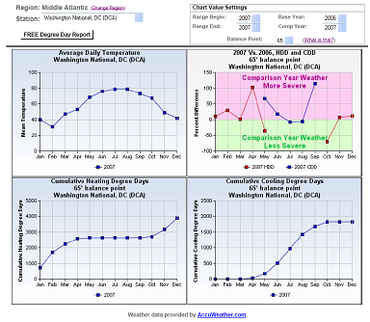
Energy Analysis
PROJECT OVERIVEW
ANALYSIS 1:
STRUCTURAL RE-DESIGN
ANALYSIS 2:
CONTROLS
ANALYSIS 3:
GREYWATER
CRITICAL INDUSTRY RESEARCH:
“GREENING” OF HOTELS
CONCLUSION
Annual weather for Washington D.C. in 2007.
68% heating and 32% cooling annually.
System | Conditioning | Duration (hrs.)
Original | Heating | 16.32
 | Cooling | 7.68
Networked | Heating* | 9.96
 | Cooling* | 4.69
81% Occupancy rate 7:30am commute 5:00pm dinner

Slide 22
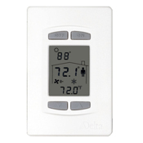
Energy Analysis
PROJECT OVERIVEW
ANALYSIS 1:
STRUCTURAL RE-DESIGN
ANALYSIS 2:
CONTROLS
ANALYSIS 3:
GREYWATER
CRITICAL INDUSTRY RESEARCH:
“GREENING” OF HOTELS
CONCLUSION
Networked Thermostat Delta DNT-T103
  Controls all FCU’s from a central computer.
  Provide user control during the day.
  “Over-ride” from 10:00pm to 7:00am
Original
Networked DNT-T103

Slide 23
Comparison & Conclusion
PROJECT OVERIVEW
ANALYSIS 1:
STRUCTURAL RE-DESIGN
ANALYSIS 2:
CONTROLS
ANALYSIS 3:
GREYWATER
CRITICAL INDUSTRY RESEARCH:
“GREENING” OF HOTELS
CONCLUSION
Delta DNT-T103 is Recommended
  $49,972.00 More than Original
  $96,478.00 Less than INNCOM
    Saves:
      696,231.56 kWh = 40% Energy annually
      $2,312.94 Energy Cost Annually

Slide 24
Analysis 3: Constructed Wetlands Greywater Treatment System

Slide 25
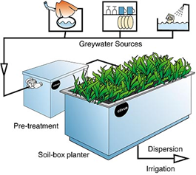
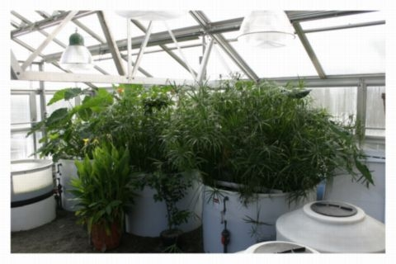
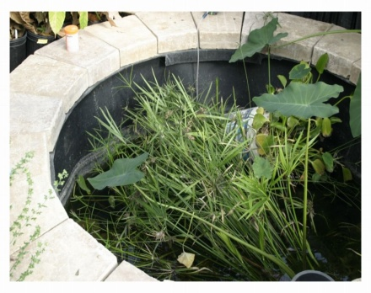
Constructed Wetlands Greywater
PROJECT OVERIVEW
ANALYSIS 1:
STRUCTURAL RE-DESIGN
ANALYSIS 2:
CONTROLS
ANALYSIS 3:
GREYWATER
CRITICAL INDUSTRY RESEARCH:
“GREENING” OF HOTELS
CONCLUSION
Background
  Hotels generate greywater: 30 Gallons/day/person
  No water recycling system in place.
Goal
  Institute Constructed Wetlands Greywater System
    Use shower water to flush toilets
    Reduce water consumption

Slide 26
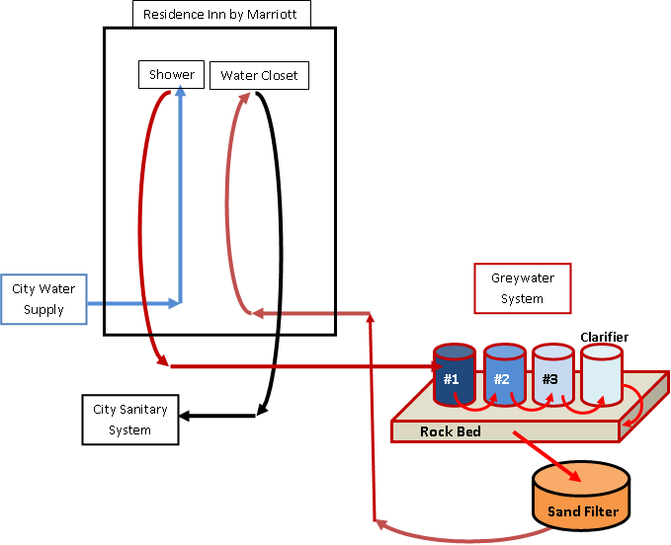
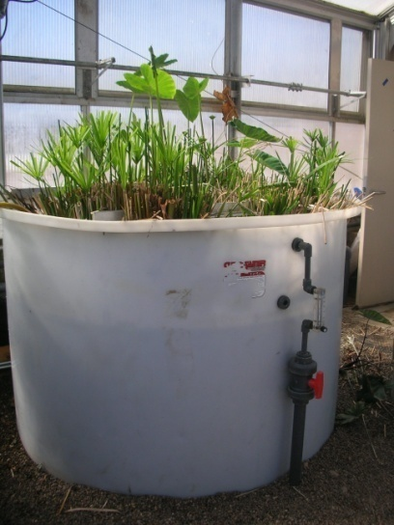
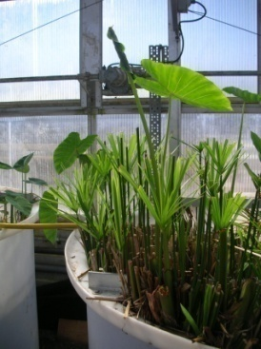
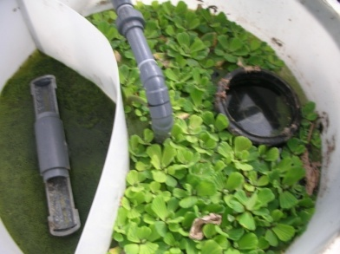
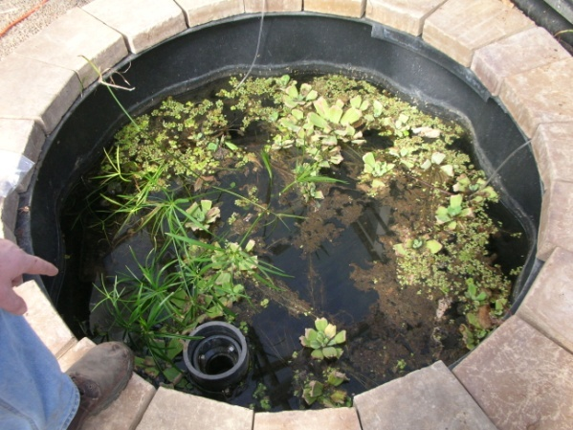
Constructed Wetlands Analysis
PROJECT OVERIVEW
ANALYSIS 1:
STRUCTURAL RE-DESIGN
ANALYSIS 2:
CONTROLS
ANALYSIS 3:
GREYWATER
CRITICAL INDUSTRY RESEARCH:
“GREENING” OF HOTELS
CONCLUSION
10 Day Process

Slide 27
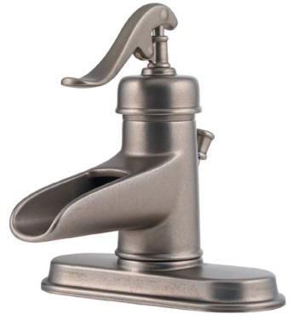
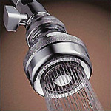
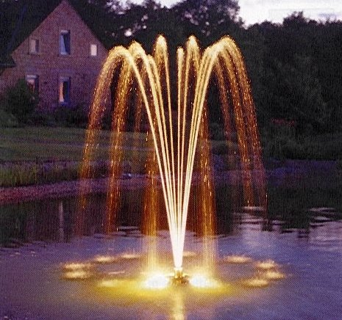
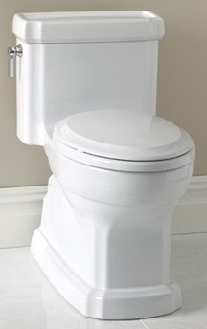
Constructed Wetlands Analysis
PROJECT OVERIVEW
ANALYSIS 1:
STRUCTURAL RE-DESIGN
ANALYSIS 2:
CONTROLS
ANALYSIS 3:
GREYWATER
CRITICAL INDUSTRY RESEARCH:
“GREENING” OF HOTELS
CONCLUSION
Occupancy rate of 81% → 203 people.
5,075 gal supply > 974.4 gal demand
  Surplus of 4,100 gallons a day.
Use 1/3 of supply, 83 people → Toilets and Fountain
  2,075 gal supply = 974.4 gal demand
  + 1100 gal fountain

Slide 28
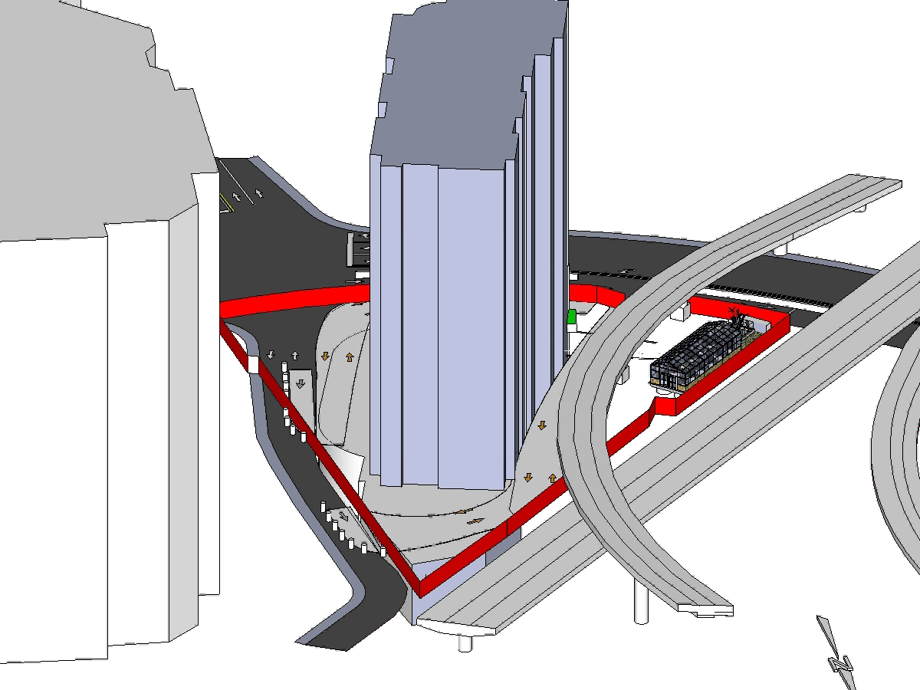
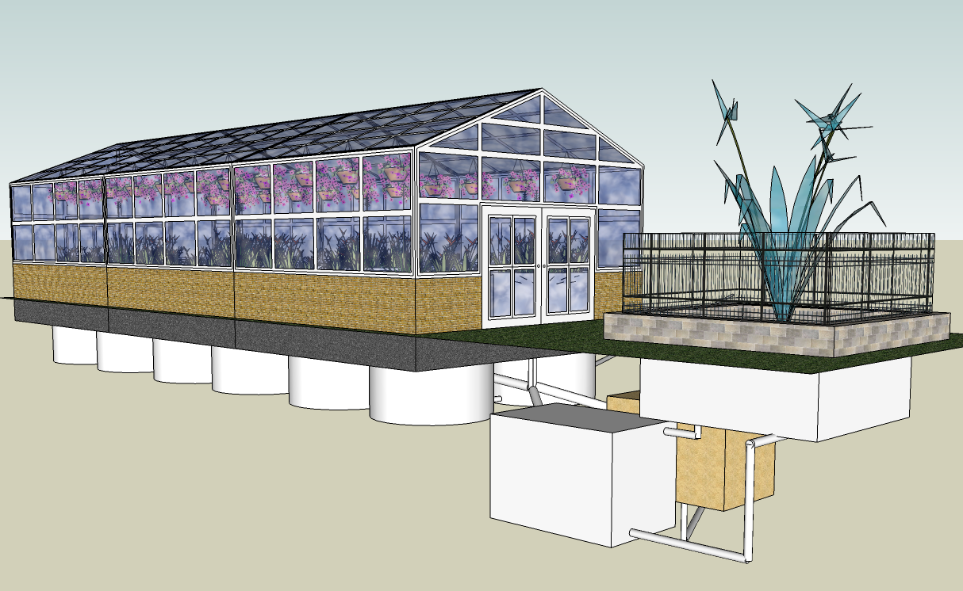
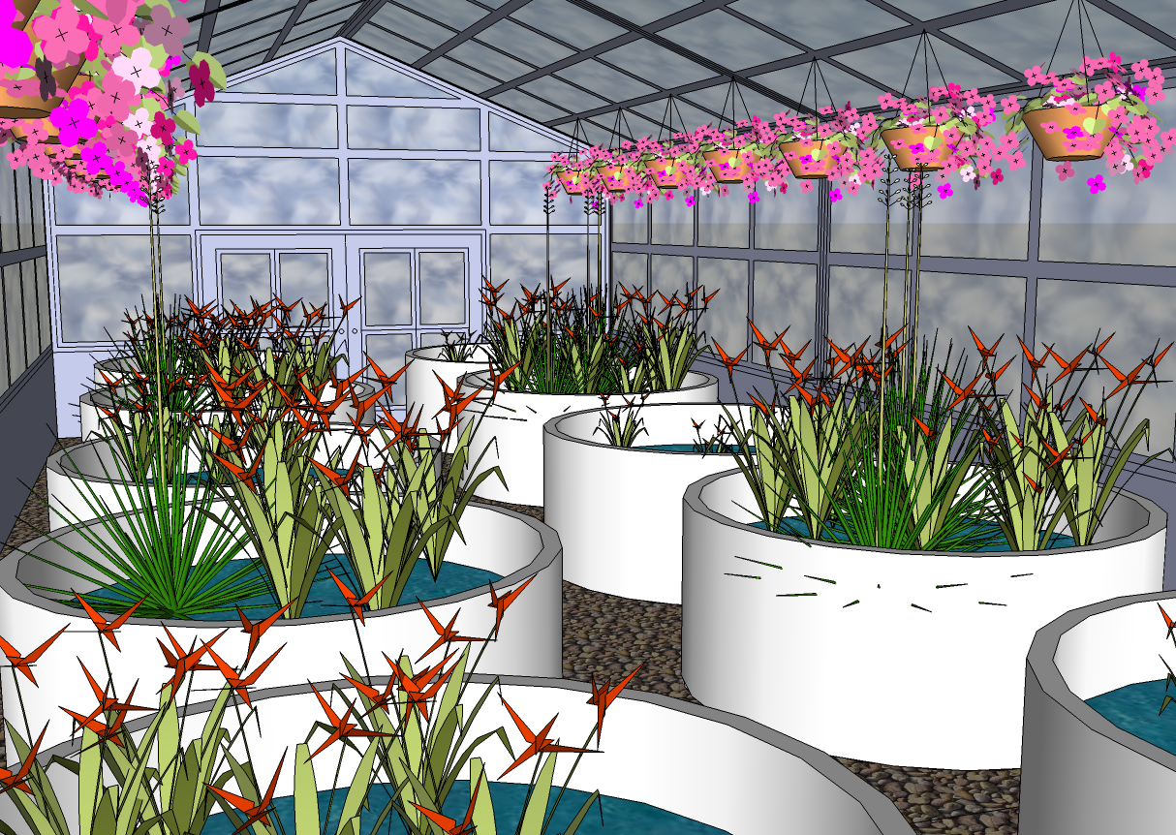
Constructed Wetlands Analysis
PROJECT OVERIVEW
ANALYSIS 1:
STRUCTURAL RE-DESIGN
ANALYSIS 2:
CONTROLS
ANALYSIS 3:
GREYWATER
CRITICAL INDUSTRY RESEARCH:
“GREENING” OF HOTELS
CONCLUSION

Slide 29
System Review
PROJECT OVERIVEW
ANALYSIS 1:
STRUCTURAL RE-DESIGN
ANALYSIS 2:
CONTROLS
ANALYSIS 3:
GREYWATER
CRITICAL INDUSTRY RESEARCH:
“GREENING” OF HOTELS
CONCLUSION
Total Greywater System Cost = | $68,298.09
Add 30% for Shipping and Customization of Tanks
Total Greywater System Cost = | $88,787.52

Slide 30
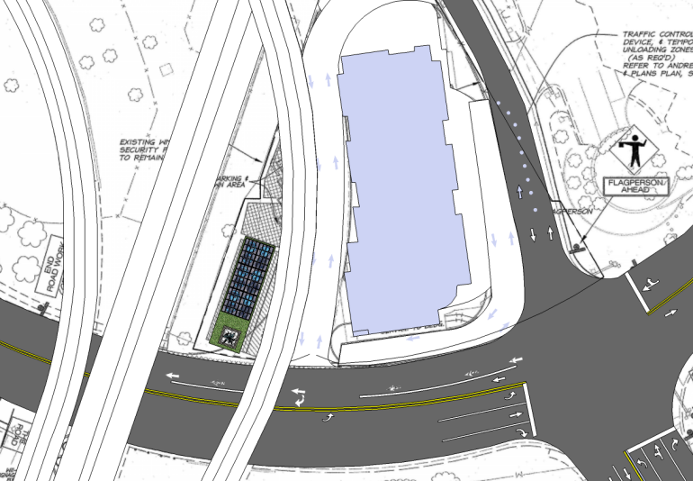
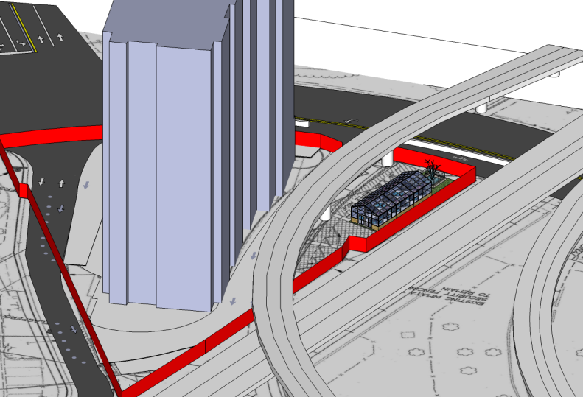
Conclusion & Recommendation
PROJECT OVERIVEW
ANALYSIS 1:
STRUCTURAL RE-DESIGN
ANALYSIS 2:
CONTROLS
ANALYSIS 3:
GREYWATER
CRITICAL INDUSTRY RESEARCH:
“GREENING” OF HOTELS
CONCLUSION
Costs $88,787.52
Adds to schedule
Saves:
  757,375 gallons = 60% Water annually
  $518.80 Water costs annually

Slide 31
Critical Industry Research:
“Greening” of Hotels

Slide 32
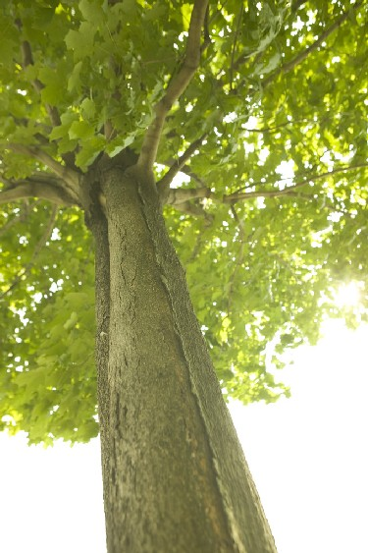

“Greening” of Hotels
PROJECT OVERIVEW
ANALYSIS 1:
STRUCTURAL RE-DESIGN
ANALYSIS 2:
CONTROLS
ANALYSIS 3:
GREYWATER
CRITICAL INDUSTRY RESEARCH:
“GREENING” OF HOTELS
CONCLUSION
Background
  There is an unfortunate misconception in this industry that adding green value or achieving LEED points simply costs too much.
  Alexandria, VA requires new construction to have at least 20 LEED points.
  Marriott firmly believes in adding green or LEED credits to many of their new hotels and resorts.

Slide 33
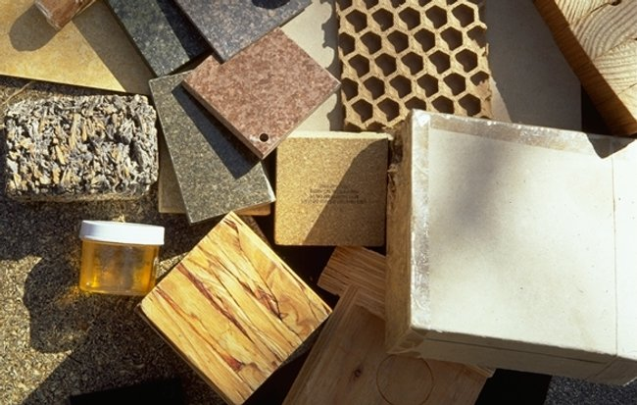

“Greening” of Hotels
PROJECT OVERIVEW
ANALYSIS 1:
STRUCTURAL RE-DESIGN
ANALYSIS 2:
CONTROLS
ANALYSIS 3:
GREYWATER
CRITICAL INDUSTRY RESEARCH:
“GREENING” OF HOTELS
CONCLUSION
Goal
  Investigate the sustainability or “Greening” of hotels by incorporating green design and analyzing the corresponding cost.
  Compare typical building materials and systems to their green alternative by:
        Upfront Cost
        Installation Cost
        Life Cost

Slide 34
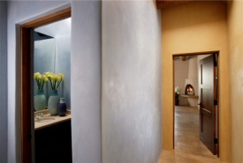
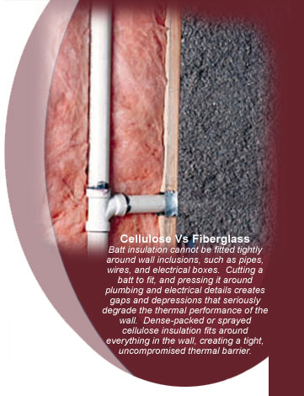
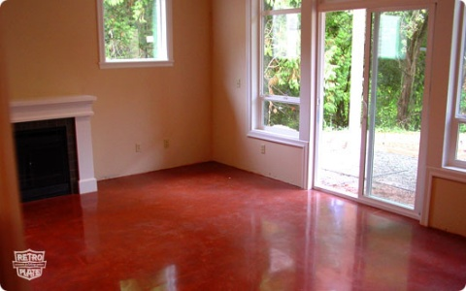
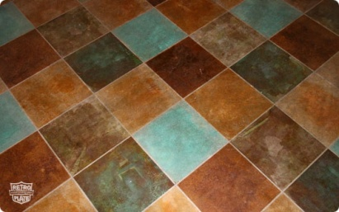

Materials & Systems
PROJECT OVERIVEW
ANALYSIS 1:
STRUCTURAL RE-DESIGN
ANALYSIS 2:
CONTROLS
ANALYSIS 3:
GREYWATER
CRITICAL INDUSTRY RESEARCH:
“GREENING” OF HOTELS
CONCLUSION
Painted Gypsum Board
Colored Clay Plaster
Fiberglass Batting Insulation
Blown Cellulose Insulation
Ceramic Tile Flooring
Polished Concrete
Continuously powered A/C units
Programmed Networked A/C units
Typical Sanitary System
Constructed Wetlands Greywater System

Slide 35
Initial Survey
PROJECT OVERIVEW
ANALYSIS 1:
STRUCTURAL RE-DESIGN
ANALYSIS 2:
CONTROLS
ANALYSIS 3:
GREYWATER
CRITICAL INDUSTRY RESEARCH:
“GREENING” OF HOTELS
CONCLUSION
Purpose
  Gain an initial opinion regarding green technologies.
Results
  Greater understanding the LEED system than GREEN technologies.
  No consistency between the participants as to which is better.
  Green is most cost effective.

Slide 36
Final Survey
PROJECT OVERIVEW
ANALYSIS 1:
STRUCTURAL RE-DESIGN
ANALYSIS 2:
CONTROLS
ANALYSIS 3:
GREYWATER
CRITICAL INDUSTRY RESEARCH:
“GREENING” OF HOTELS
CONCLUSION
Purpose
  Research overview
  Determine effectiveness
Results of Material & System Comparison
  Painted Gypsum Board
  Either Insulation
  Polished Concrete
  Programmed A/C Units
  Greywater System

Slide 37
Research Conclusion
PROJECT OVERIVEW
ANALYSIS 1:
STRUCTURAL RE-DESIGN
ANALYSIS 2:
CONTROLS
ANALYSIS 3:
GREYWATER
CRITICAL INDUSTRY RESEARCH:
“GREENING” OF HOTELS
CONCLUSION
  Most participants did not have a clear understanding of what costs are associated with each product.
Green technologies are favored among industry members, and are regarded as cost effective.
Overall, it shows that when presented with hard numbers in terms of cost and savings, the decision makers chose the environmentally friendly alternative.

Slide 38
Conclusions

Slide 39
Thesis Conclusions
PROJECT OVERIVEW
ANALYSIS 1:
STRUCTURAL RE-DESIGN
ANALYSIS 2:
CONTROLS
ANALYSIS 3:
GREYWATER
CRITICAL INDUSTRY RESEARCH:
“GREENING” OF HOTELS
CONCLUSION
System | Cost Savings | Additional Savings
Slab and Beam Filigree Structure | $340,644.45 | $1,190,700.00 Added Revenue in 45 Nights
Delta Controls DNT-T103 | $98,790.94 | 696,231.56 kWh of Energy Annually (40%)
Constructed Wetlands Greywater | -$88,268.72 | 757,375.00 Gallons of Water Annually (60%)
Grand Total Cost Savings | $351,166.67
The Filigree slab and beam system is the recommended system based on structural design, cost, schedule, and constructability. Brings in approximately $1,190,700.00 in revenue.
The Delta Controls system using the DNT – T103 is the recommended system to reduce energy consumption.
The constructed wetlands greywater system is recommended because Marriott is extremely focused on helping the environment and increasing aesthetic appeal of the building.

Slide 40
Questions or Comments??

Slide 41
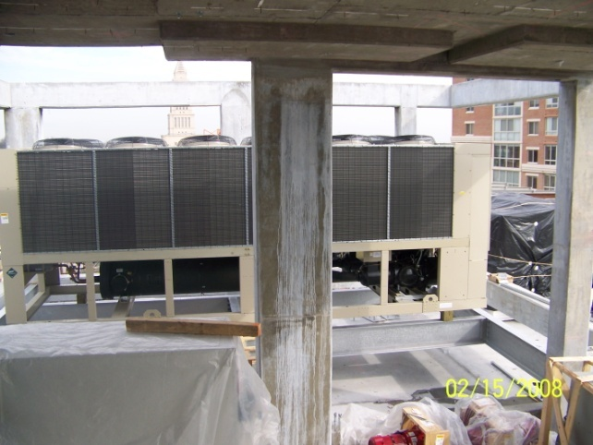
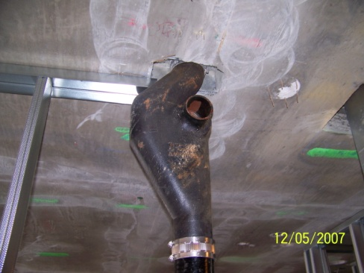
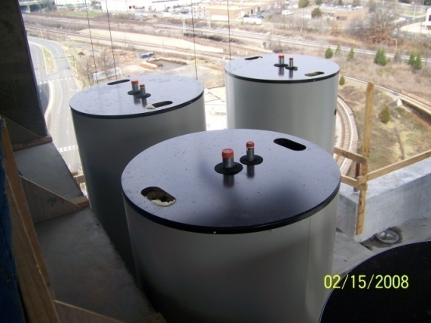
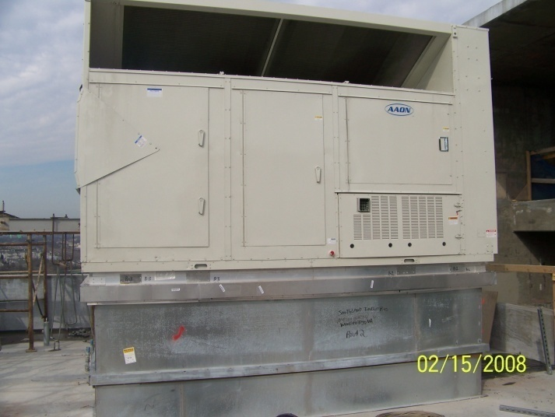
Building Systems
PROJECT OVERIVEW
ANALYSIS 1:
STRUCTURAL RE-DESIGN
ANALYSIS 2:
CONTROLS
ANALYSIS 3:
GREYWATER
CRITICAL INDUSTRY RESEARCH:
“GREENING” OF HOTELS
CONCLUSION
Lighting/Electrical
  3000 amp @ 480/277 volt 3ø. 4W. Switchboard
  400 kw, 480 v back-up generator
Mechanical
  (1) 155 ton Chiller
  (2) 1.53 mil BTU Boilers, for AHU’s
  (2) 1.43 mil BTU Shell and Tube Heat Exchangers
  Chilled Water / Electric Heat FCU’s in guestrooms

Slide 42
Stud Rail Design
PROJECT OVERIVEW
ANALYSIS 1:
STRUCTURAL RE-DESIGN
ANALYSIS 2:
CONTROLS
ANALYSIS 3:
GREYWATER
CRITICAL INDUSTRY RESEARCH:
“GREENING” OF HOTELS
CONCLUSION
No Existing Edge Beams
Exterior Panels → ln/30
Interior Panels → ln/33
h = 10 in. d = 8.50 in.
P = 1.2D + 1.6L = 214 psf
Distributed Load = 3.745 kips
Tributary Load at Column
  V_{u} = P * w * (1/2d + 1/2l) = 68.35 kips
Effective Width
  b_{o} = 130.00 in.
Shear Strength
Ф = 0.75
ФVc = Ф4 * √f'c * bo * d = 234.41 kips > 68.35 kips
No Shear Stud Rails Required
30”
18”
d/2

Slide 43
Constructed Wetlands Analysis
PROJECT OVERIVEW
ANALYSIS 1:
STRUCTURAL RE-DESIGN
ANALYSIS 2:
CONTROLS
ANALYSIS 3:
GREYWATER
CRITICAL INDUSTRY RESEARCH:
“GREENING” OF HOTELS
CONCLUSION
20,750 gallons per 10 days
  Half held in rock bed, Half in “biofilter” tanks
  (8) 6,800 gallon tanks required
    2 sets of each: 3 “biofilter” tanks, 1 clarifier tank
With 25% Safety Factor = 3,468 CF = 1,206 SF rock bed, 25’ x 50’
6,800 gallon Sand Filter or Fountain Storage tank

Slide 44
Final Survey
PROJECT OVERIVEW
ANALYSIS 1:
STRUCTURAL RE-DESIGN
ANALYSIS 2:
CONTROLS
ANALYSIS 3:
GREYWATER
CRITICAL INDUSTRY RESEARCH:
“GREENING” OF HOTELS
CONCLUSION
Technology |  |  | Material Up Front Cost |  | Installed Cost (labor) |  | Total Cost |  | Life Cost |  | Product Life (Yrs.) |  | Choose One
Colored Clay Plaster |  |  | 0.21 | $/SF | 7.8 | $/SF | 8.01 | $/SF | 0.11 | $/SF/Yr | 75
Painted Gypsum Board |  |  | 0.35 | $/SF | 3 | $/SF | 3.35 | $/SF | 0.13 | $/SF/Yr | 25
Blown Cellulose Insulation |  |  | 1.45 | $/CF | 1.52 | $/CF | 2.97 | $/CF | 0.10 | $/CF/Yr | 30
Fiberglass Batting Insulation |  |  | 0.7 | $/SF | 0.27 | $/SF | 0.97 | $/SF | 0.06 | $/SF/Yr | 15
Polished Concrete Floor |  |  | 1.75 | $/SF | 7.25 | $/SF | 9 | $/SF | 0.09 | $/SF/Yr | Building Life
Ceramic Tile Floor |  |  | 8.44 | $/SF | 3.26 | $/SF | 11.7 | $/SF | 0.23 | $/SF/Yr | 50
Pre-Prgrammed A/C Units* |  |  | 98 | $/Unit | $50,000.00 |  | $68,522.00 |  | 362.55 | $/Unit | n/a
Continuously Powered A/C Units |  |  | 30 | $/Unit | $32,230.00 |  | $37,900.00 |  | 200.53 | $/Unit | n/a
Greywater System* |  |  | n/a |  | n/a |  | Add $150,000 |  | n/a |  | Building Life
Normal Sanitary System |  |  | n/a |  | n/a |  | n/a |  | n/a |  | Building Life
Building Life is assumed to be 100 years.
Pre-Prgrammed A/C Units* |  |  | Saves 696,241.5 kWh/Year = $2,312.94 /Year
Greywater System* |  |  | Saves 355,656 Gallons of Water/Year = $487.25 /Year

Slide 45
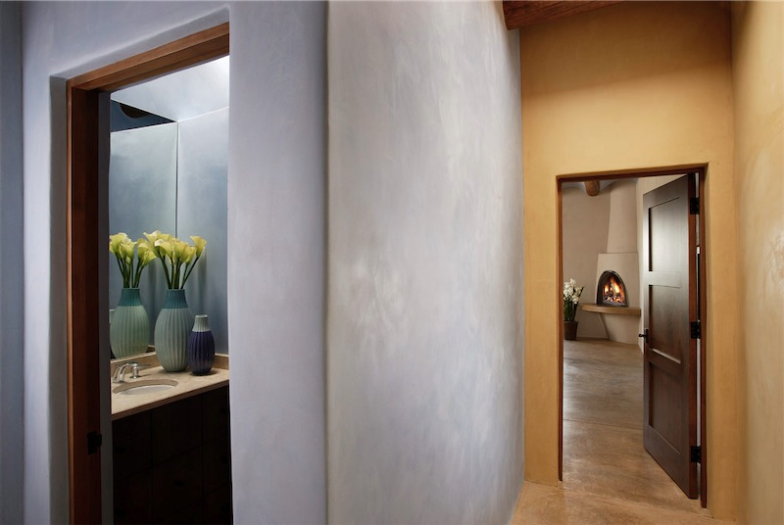
Materials & Systems
PROJECT OVERIVEW
ANALYSIS 1:
STRUCTURAL RE-DESIGN
ANALYSIS 2:
CONTROLS
ANALYSIS 3:
GREYWATER
CRITICAL INDUSTRY RESEARCH:
“GREENING” OF HOTELS
CONCLUSION
Painted Gypsum Board
Colored Clay Plaster
Used for wall covering and acoustics
Double layers between guestrooms and on North, West, and South façades.
Flexible and workable
Stained instead of paint
Equivalent acoustics
Derived from a Renewable Resource
Survey Results: Painted Gypsum Board
Ease Installation and Repair
Lower upfront cost
Easier to renovate
Excellent Material BUT Difficult to Install and Repair Properly
Higher upfront cost BUT longer product life
Difficult to renovate

Slide 46
Materials & Systems
PROJECT OVERIVEW
ANALYSIS 1:
STRUCTURAL RE-DESIGN
ANALYSIS 2:
CONTROLS
ANALYSIS 3:
GREYWATER
CRITICAL INDUSTRY RESEARCH:
“GREENING” OF HOTELS
CONCLUSION
Fiberglass Batting Insulation
Blown Cellulose Insulation
Specified widths = 6”
In all walls for acoustics
Noncombustible
Any volume
Inhibits air infiltration and good for acoustics
Class A Fire Rating
Survey Results: Both
Easy Installation for Stud Cavities
Equivalent Life Cost
Better Thermal Performance

Slide 47


Materials & Systems
PROJECT OVERIVEW
ANALYSIS 1:
STRUCTURAL RE-DESIGN
ANALYSIS 2:
CONTROLS
ANALYSIS 3:
GREYWATER
CRITICAL INDUSTRY RESEARCH:
“GREENING” OF HOTELS
CONCLUSION
Ceramic Tile Flooring
Polished Concrete
Add Grout and Tile
Higher Installation Cost
Multiple Colors and Patterns
Sand and Polish Existing Concrete Floor
Can be Stained and Patterned
Survey Results: Polished Concrete
Long Life Cost
Difficult to Repair need Skilled Labor
Architectural Appeal
Lower Upfront Cost
Longer Product Life
“Good Savings and a Durable Solution”

Slide 48

Materials & Systems
PROJECT OVERIVEW
ANALYSIS 1:
STRUCTURAL RE-DESIGN
ANALYSIS 2:
CONTROLS
ANALYSIS 3:
GREYWATER
CRITICAL INDUSTRY RESEARCH:
“GREENING” OF HOTELS
CONCLUSION
Survey Results:
Programmed Networked A/C units
Survey Results:
Constructed Wetlands Greywater
Higher Upfront Cost justified by Energy Savings
Water savings outweighed Upfront Cost
Need Proper Design, Installation, and Maintenance

